Slide 1
When Node meets Angular

Slide 2
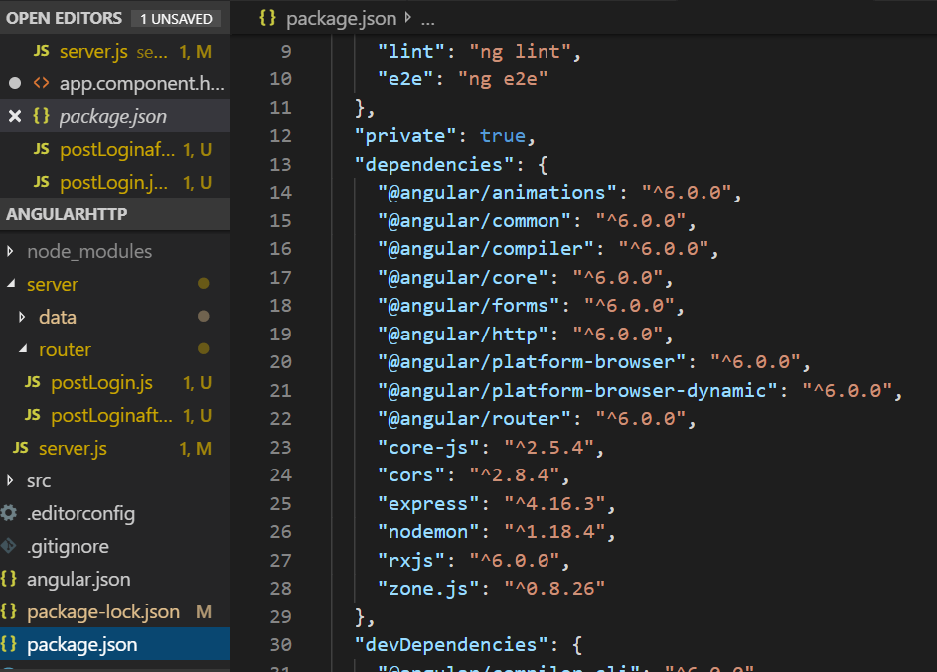
Combine Node Project and Angular Project
First generate Angular project and in the angular folder, set the server folder and files server.js etc.
Thus, you need only push one git repository to github.
If you like, the server project can share the same package.json file, so that we can run npm install once for two projects. In this case, you may run npm install express and other node packages from the root of the angular project.

Slide 3
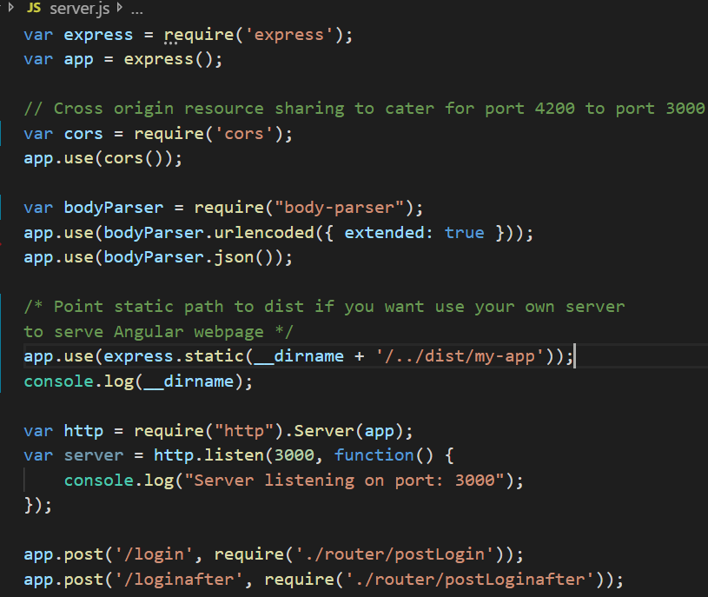
Server.js
A server can be built by express as starting point.
If you want your own node server to server Angular webpage, you can. However, you need to build the angular index.html file and use correct path. To be safe, you may check what is __dirname
We may provide some routes, which can be given as separate files.

Slide 4

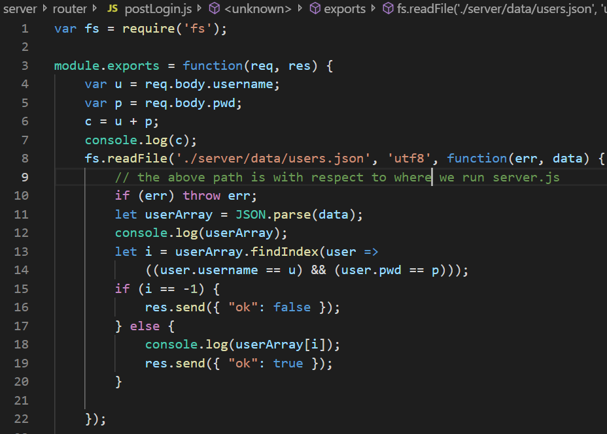
Server.js
We may provide some other more complicated routes as above.
The first parameter of routes is a url, and the second one is a callback function, which is more important and is usually given as a separate file
One of them is shown in the right as an example.

Slide 5
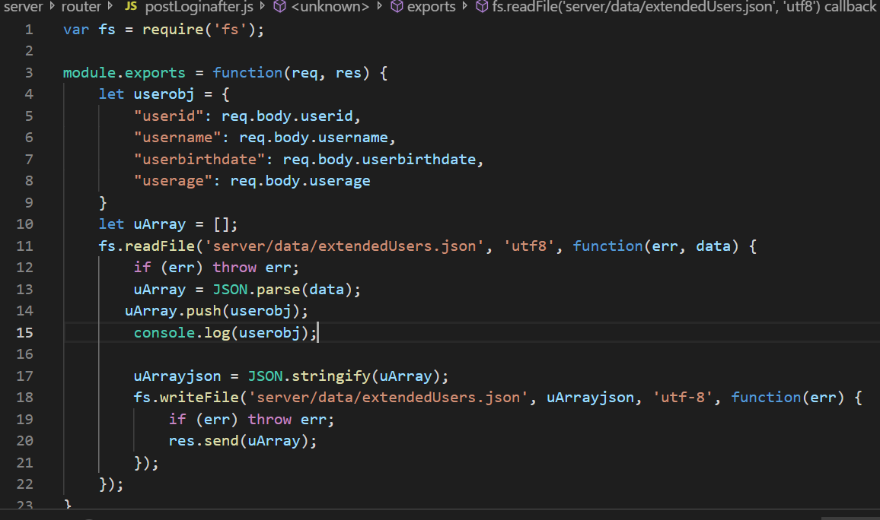
Route
The callback function in a route has two parameters, req and res, telling how to data from the front-end and how to give response to the front-end

Slide 6
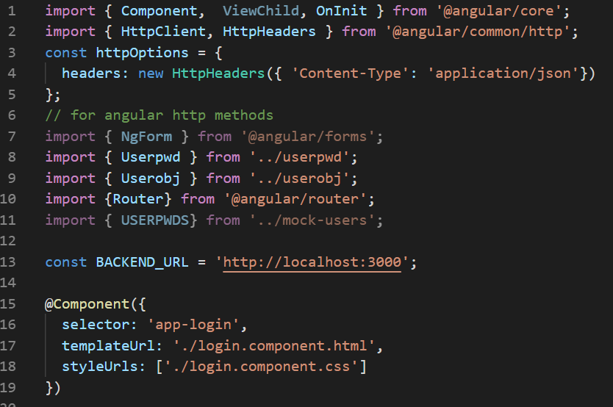
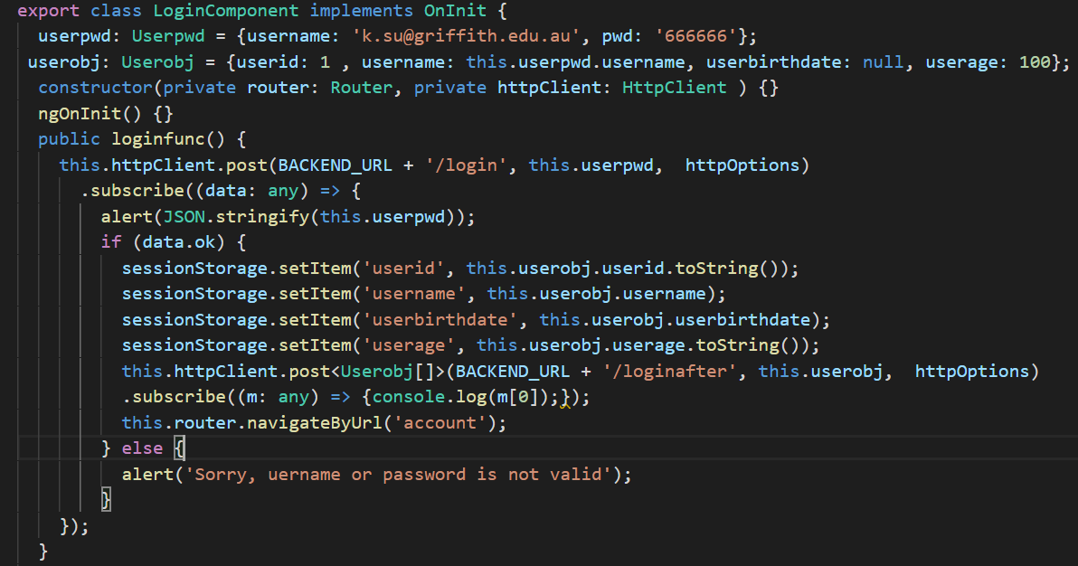
From Angular to Node and back by Using HttpClientModule

Slide 7
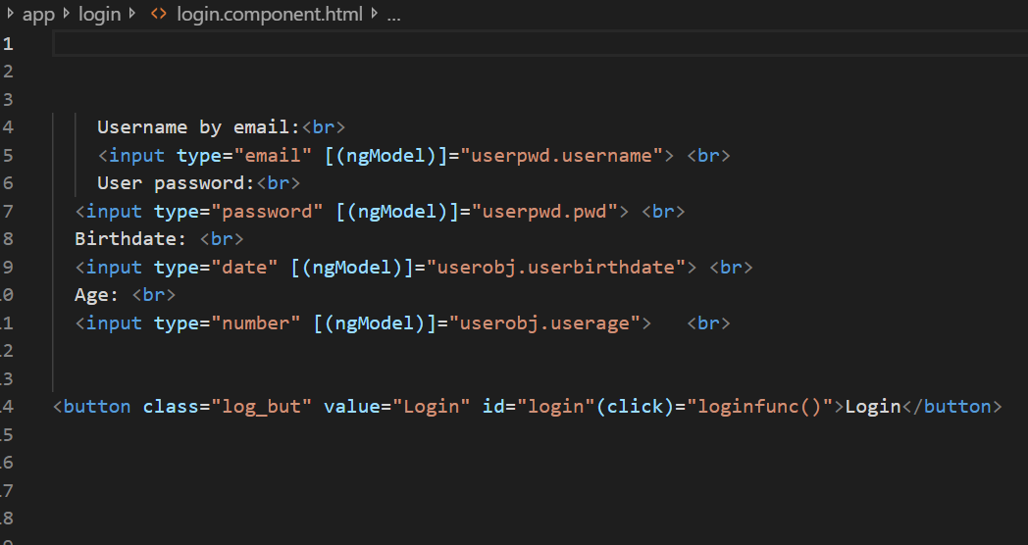
Login.component.html
The html for login component:
Each input has a property [(ngModel)] for bi-binding the value in the ts file.
The click button is related to the method loginfunc(), which is defined in the ts file.

Slide 8
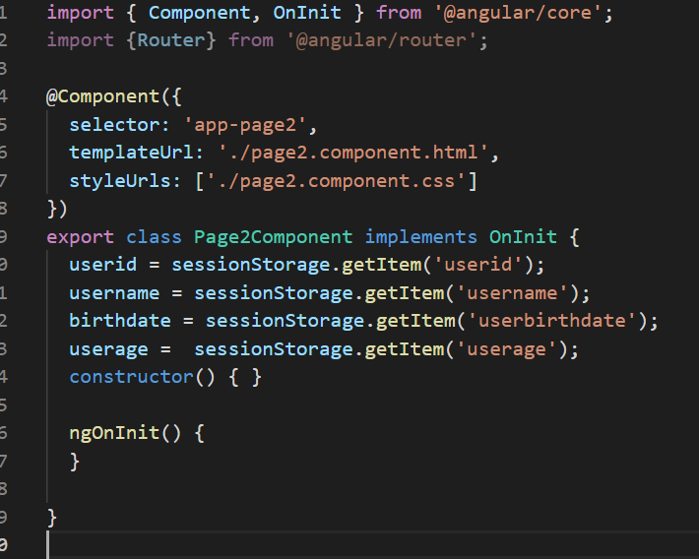
Retrieve data from sessionStorage
We may retrieve data from sessionStorage in the ts file and display as a list or table in the web component page (in html file).

